Slide 1
Spam Detection in YouTube Comments Using
Machine Learning
Project Presentation
CSE 431
Team 28
20341021 Tasin Mohammad
RA: Ehsanur Rahman Rhythm
ST: Farah Binta Haque

Slide 2
01
Dataset

Slide 3
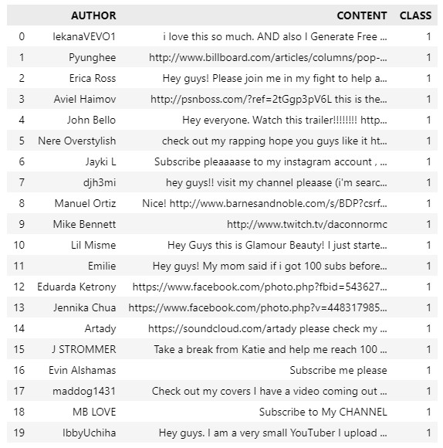
Dataset
Collected From Kaggle
1956 Rows
Contains Comments From Music Videos

Slide 4
02
Visualization

Slide 5
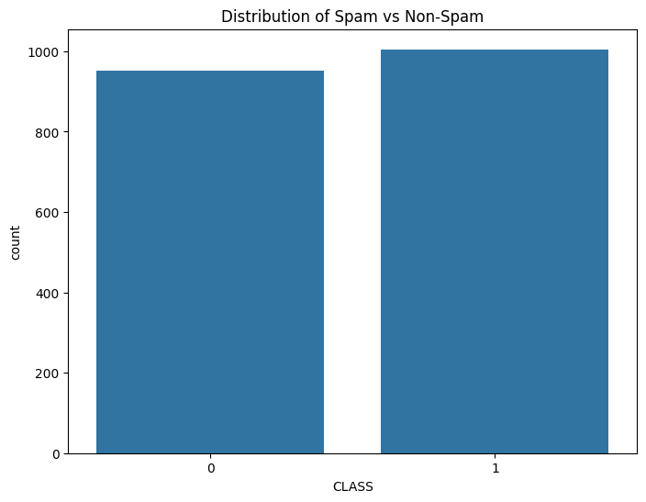
Dataset Visualization

Slide 6
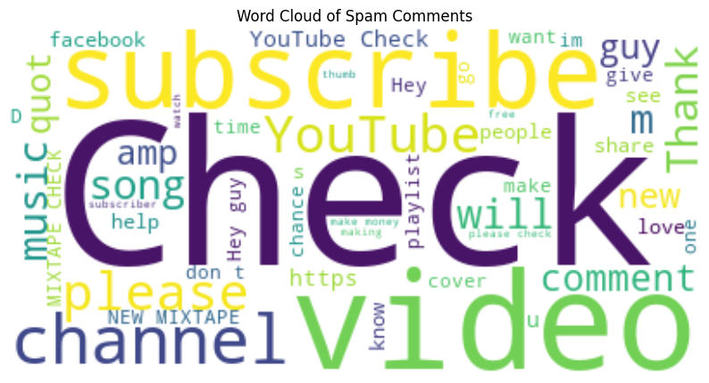
Dataset Visualization

Slide 7
03
Data Preprocessing

Slide 8
Data Preprocessing
Converted The Comments into Vectorized Tokens using CountVectorizer
CountVectorizer gave better results when compared to TF-IDF

Slide 9
04
Results

Slide 10
ML Algorithms
Bernoulli Naive Bayes
Naive Bayes is a probabilistic algorithm that is computationally efficient and easy to implement.
It performs particularly well with text classification tasks, making it suitable for spam detection in comments where the data is often textual.
Random Forest
Random Forest is an ensemble learning method that combines the predictions of multiple decision trees. This often leads to more robust and accurate models.
Random Forest can capture complex relationships in the data and handle non-linear decision boundaries, making it suitable for tasks where spam comments may have diverse characteristics.
Support Vector Machines (SVM):
SVMs work well in high-dimensional spaces, making them suitable for text classification tasks where the feature space can be large.
SVMs can use the kernel trick to transform the input data into a higher-dimensional space, which can help capture complex relationships in the data.

Slide 11
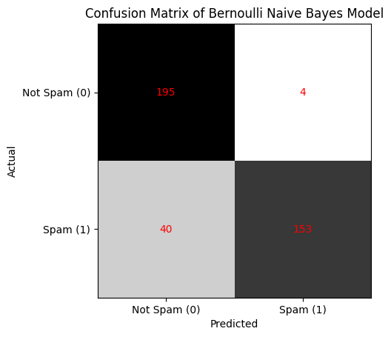
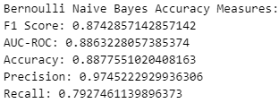
Bernoulli Naive Bayes

Slide 12
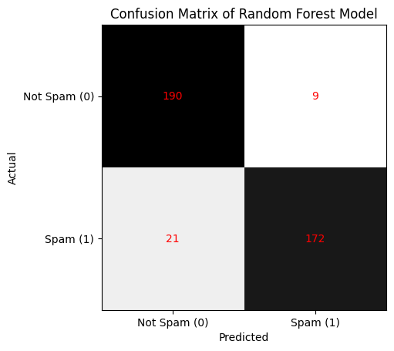
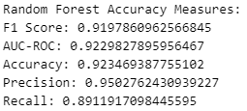
Random Forest

Slide 13
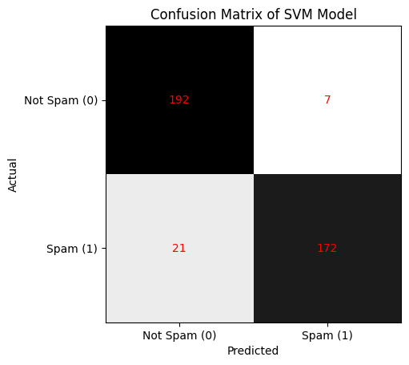
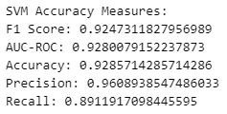
SVM

Slide 14
06
Conclusion
In this project, I worked on a system in which various classification algorithms were applied.
Among all the models, SVM performed the best.
I intend to inspect further and consider both accuracy and comprehensibility.

Slide 15
Thanks!

